Slide 1
◊ IoT Hands-on Labs ◊ Lab 5. Cayenne Platform
IoT Lecture Series
Prof. John Lee
IUPUI & KAIST

Slide 2
Cayenne Tutorial
Create an account on http://mydevices.com
Follow https://mydevices.com/cayenne/docs/#introduction

Slide 3
Setting up Arduino IDE (skip if you did)
Need to install Arduino IDE
Need to install ESP8266 Board Manager
Need to install ESP8266 Library
Use the same board we used in the previous labs
See Hands-on IoT Lab 1

Slide 4
Cayenne Lab
Download this code (if not done yet)
Cayenne_simulated_test_code.ino
From https: https://github.com/indystar1/ESP8266-code-various/Cayenne_simulated_test_code
Modify accordingly
Connect power to the hardware
Setup target board, port, speed, etc.
Compile and upload
Follow https://mydevices.com/cayenne/docs/#introduction

Slide 5
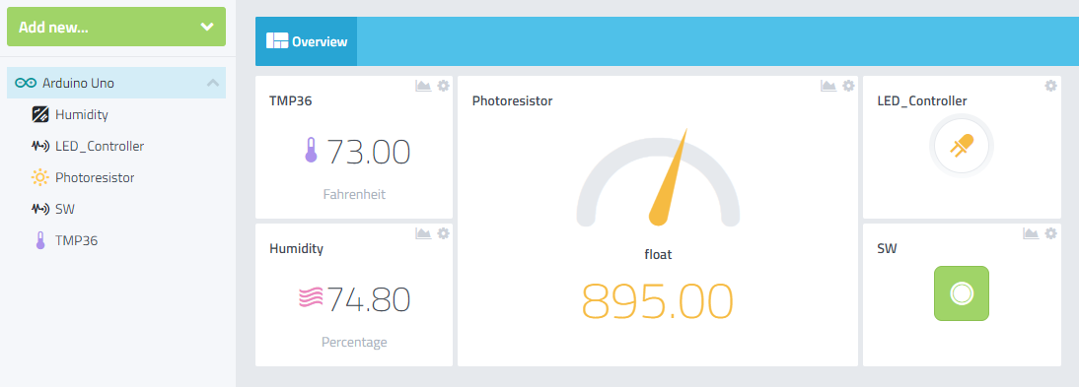
Sample Screen Shot of The Tutorial

